Slide 1
Inter-process Communication

Slide 2
Overview
Inter-process communication
  Unicast, multicast.
Archetypal IPC Program Interface.
Event synchronisation:
  Synchronous and asynchronous operations & scenarios.
  Timeouts, threading and deadlocks.
Data Representation:
  Data marshalling and encoding.
Protocols:
  Text-based, HTTP example

Slide 3
Overview
Connection-oriented V’s Connectionless IPC.
Evolution of Paradigms for IPC.

Slide 4
Inter-process Communications
Distributed computing requires information to be exchanged among independent processes across a network
We will look at the fundamentals, issues, paradigms and the implementations of IPC.

Slide 5
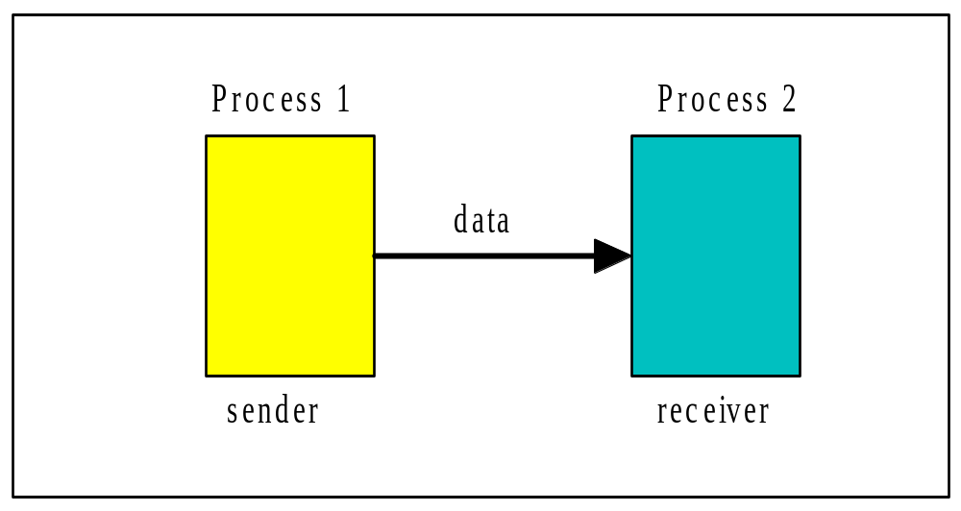
Basic Inter-process Communication - 1
Two independent processes – local or remote.
Exchange data over an interconnecting network.

Slide 6
Basic Inter-process Communication - 2
In distributed computing two processes engage in IPC in a protocol.
Set of rules that must be observed by the participants in data communication. (e.g. ftp, http etc)
Agreement made between the processes.
A process may be a sender at some points during a protocol, a receiver at other points.

Slide 7
IPC – Unicast and Multicast
When communication is from one process to a single other process, the IPC is said to be a unicast.
When communication is from one process to a group of processes, the IPC is said to be a multicast

Slide 8
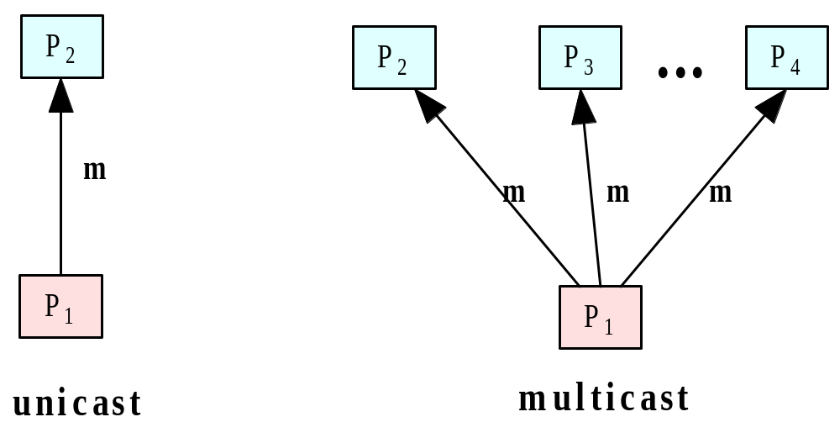
Unicast vs. Multicast

Slide 9
Inter-process Communication
Operating systems like UNIX (Linux, etc) and Windows provide IPC support – called operating system level IPC’s – ( texts on Operating Systems.)
System-level IPC’s include: message queues, semaphores and shared memory.
High-level IPC’s – (we will examine.)
An IPC API (application programming interface) provides an abstraction of system-level facilities.
Programmer can then concentrates on application logic.

Slide 10
An Archetypal IPC API - 1
An IPC API provides 4 primitive operations which allows for a minimum level of abstraction to facilitate IPC:
  Send
  Receive
  Connect
  Disconnect

Slide 11
An Archetypal IPC API - 2
Send
  Issued by sending process.
  Transmits data to receiving process.
  Sender must identify receiving process and specify data to send.
Receive
  Issued by the receiving process.
  Purpose - to accept data from the sender.
  Receiver must be able to identify the sending process and specify memory space to hold sent data.

Slide 12
An Archetypal IPC API - 2
Connect
  For connection-oriented IPC – operations needed that allow a logical connection to be made between sender and receiver.
  Sender issues request-to-connect, receiving process issues a accept-connection.
Disconnect
  connection-oriented IPC – operation allows a logical connection to be disconnected at either end.

Slide 13
An Archetypal IPC API - 3
Process involved in IPC issues the operations in a pre-defined order.
Issuing an operation causes an event.
IPC operation are are provided implicitly or explicitly in every distributed computing paradigm we will study

Slide 14
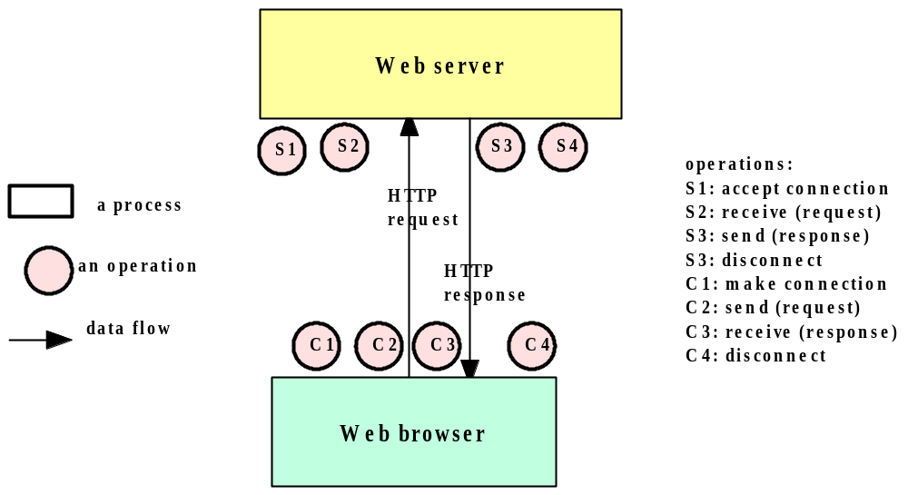
Example: IPC in Basic HTTP - Operations

Slide 15
Event synchronisation
Inter-process communication requires that the two processes synchronise their operations.
IPC operations are issued in a specific order.
One side sends, then the other receives until all data has been sent and received.
In practice, the synchronisation requires system support.

Slide 16
Synchronous vs. Asynchronous Communication
The IPC operations may provide the synchronisation necessary using one of two methods:
  Blocking – Synchronous operations.
    Blocking operation issued by a process will block further processing of the process until the operation is fulfilled.
  Non-blocking - Asynchronous operations.
    Non-blocking operation issued by a process will not block further processing of the process.
    Process is free to proceed with its processing, and may optionally be notified by the system when the operation is fulfilled.

Slide 17
Timeouts, Threading & Deadlocks
Indefinite blocking - process suspended (or “hang”) indefinitely - not recommended.
Caused by synchronisation or deadlocks (blocking operations in the wrong sequence).
Solutions
  Timeouts – set max time for blocking.
  Threads:
    Issues the blocking operation.
    Allows main thread or parent process to proceed with other processing

Slide 18
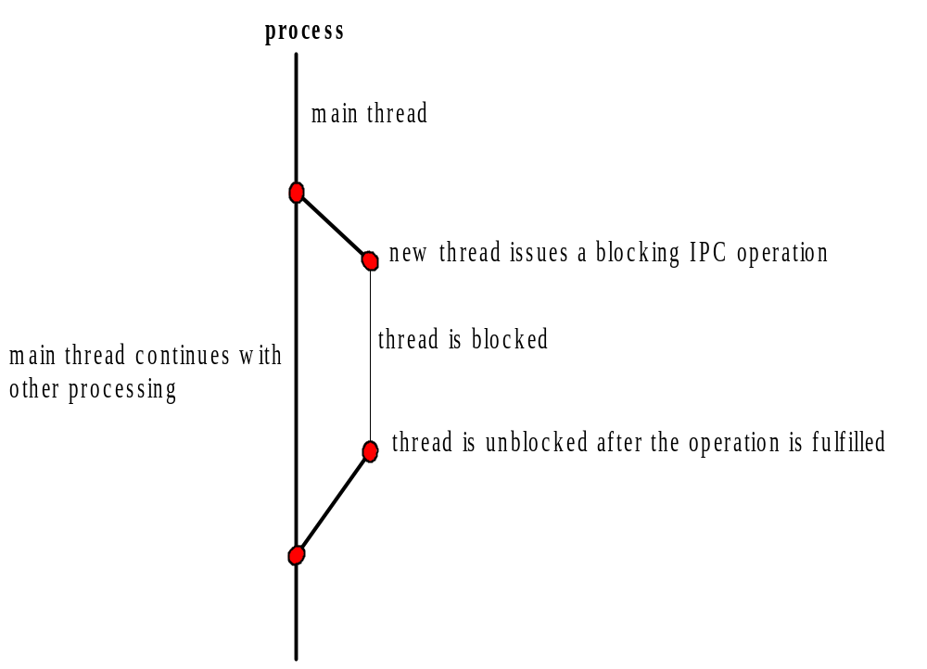
Threads for Asynchronous/Blocking IPC
Time

Slide 19
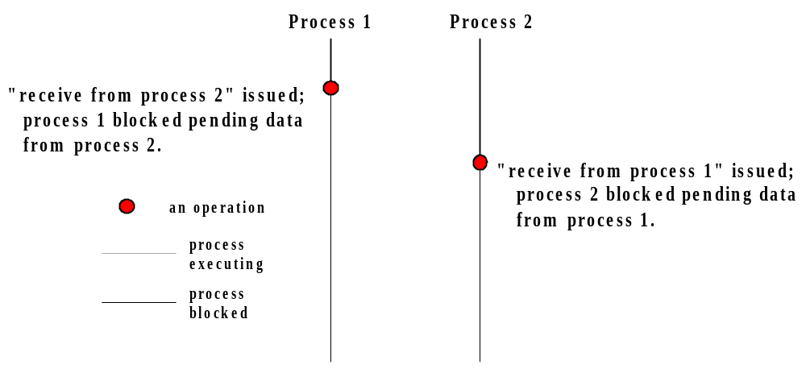
Indefinite Blocking due to a Deadlock
Timeouts can be used to detect deadlocks.

Slide 20
Data Representation - 1
At the physical layer of the n/w architecture data is transmitted as analog signals
Represents a binary stream.
At the application layer a more complex representation of data transmitted is needed.
To support the data types and data structures provided in programming languages (character strings, integers, arrays, objects, etc).

Slide 21
Data Representation - 2
Because different computers (i.e. heterogeneous hosts) may have different internal storage format for the same data type, an external representation of data may be necessary.
Data Marshalling is the process of conditioning the data to be transmitted by :
  Flattening a data structure – arrays, records (if necessary).
  Object serialization for DM of objects – data & behaviour.
  Converting the data to an external representation.

Slide 22
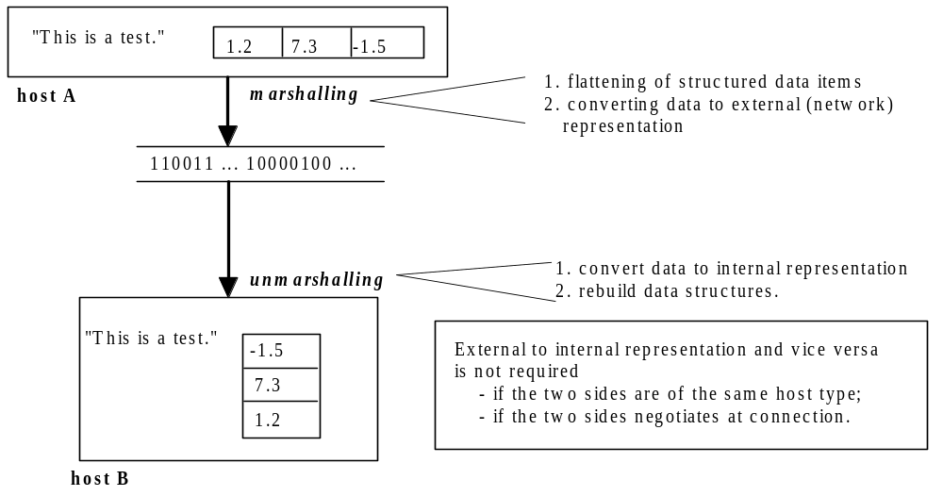
Data Marshalling - 1

Slide 23
Data Encoding
General-purpose distributed applications require a universal, platform-independent scheme for encoding exchanges data.
Called data encoding standards.
Some well known data encoding standards (i.e.external data representation schemes) are:
  Sun XDR - (RFC 1014, www.faqs.org)
  ASN.1 (Abstract Syntax Notation) - (www.asn1.org)
  XML (Extensible Markup Language) – (www.w3.org)

Slide 24
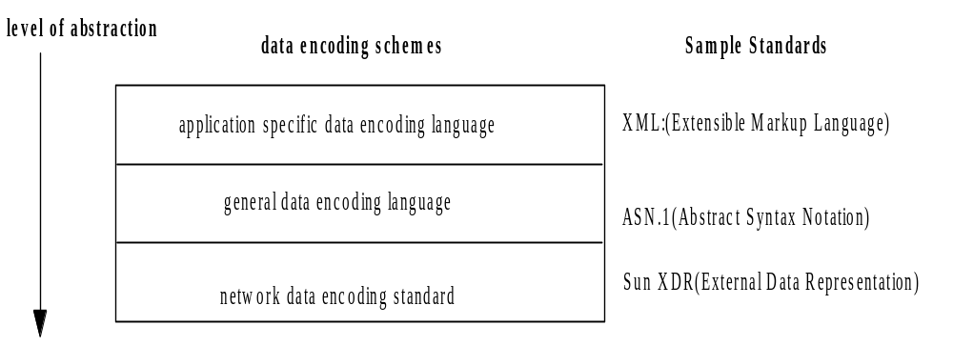
Data Encoding Protocols

Slide 25
Sample XML file
XML is a text-based markup language that has become the standard for data interchange on the Web.
XML has syntax similar to HTML.
XML tags tell you what the data means, rather than how to display it.
Example
  <message>
    <to>you@yourAddress.com</to> <from>me@myAddress.com</from>
    <subject>XML Is Really Cool</subject>
    <text> How many ways is XML cool? Let me count the ways... </text>
  </message>

Slide 26
Protocol
In a distributed application, two processes perform inter-process communication in a mutually agreed protocol.
The specification of a protocol should include:
  The sequence of data exchange, which can be described using a time event diagram.
  The specification of the format of the data exchanged at each step.

Slide 27
Text-based Protocols
Data marshalling is at its simplest when the data exchanged is a stream of characters, or text in ASCII.
Exchanging data in text has the additional advantage that the data can be easily parsed in a program and displayed for human perusal.
Popular practice for protocols to exchange requests and responses in the form of character-strings.
Such protocols are said to be text-based.
Popular network protocols, including FTP (File Transfer Protocol), HTTP, and SMTP (Simple Mail Transfer Protocol), are text-based.
Use request-response protocols.

Slide 28
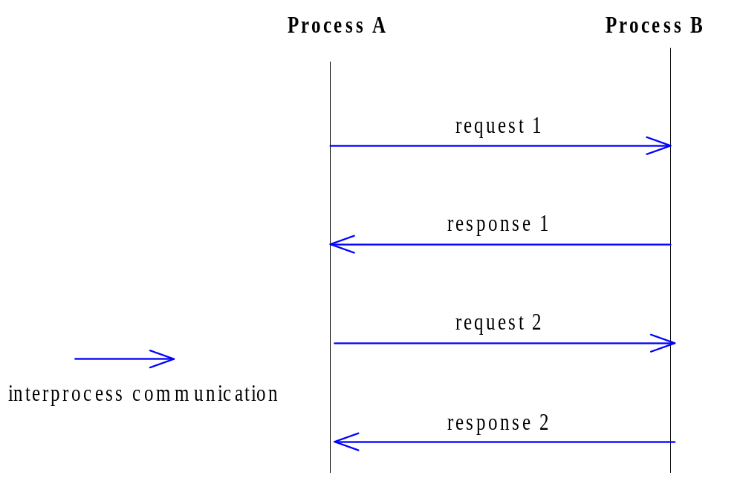
Sequence Diagram

Slide 29
HTTP: A Sample Protocol
The Hypertext Transfer Protocol is a protocol for a process (the browser) to obtain a document from a web server process.
It is a request/response protocol: a browser sends a request to a web server process, which replies with a response.

Slide 30
Sequence Diagram - HTTP Session
Event diagram to detailed for complex protocols.
Sequence diagram used to illustrate IPC.

Slide 31
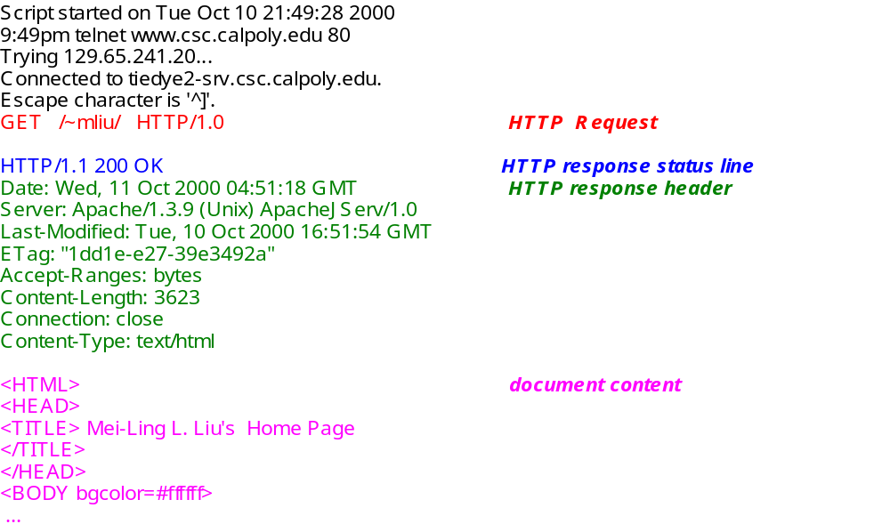
Sample HTTP Session (use F12 in Chrome to watch these messages UNDER Network - Headers/Response tabs)

Slide 32
Try the following site in Chrome with F12 or Wireshark and observe
https://www.york.ac.uk/teaching/cws/wws/webpage1.html

Slide 33
Connection-oriented V’s Connectionless IPC.
Connection-oriented IPC – Two processes establish a connection, then exchange data by inserting data to and extracting data from the connection.
Once a connection is established – no need to identify the sender or receiver.
Connectionless IPC – data is exchanged in independent packets, each of which needs to be addressed specifically to the receiver.

Slide 34
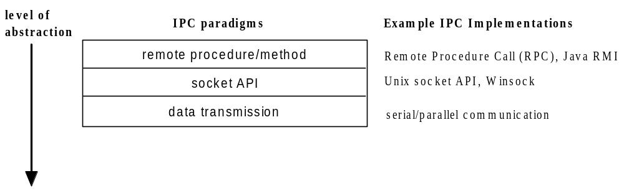
Evolution of Paradigms for Inter-process Communications (IPC)
We now understand the IPC concept.
Now examine the various paradigms through which IPC can be provided to the programmer.

Slide 35
Review - 1
Inter-process communication
  Unicast, multicast.
Archetypal IPC Program Interface.
Event synchronisation:
  Synchronous and asynchronous operations Timeouts, threading and deadlocks.
Data Representation:
  Data marshalling and encoding.
Protocols:
  Text-based, HTTP example

Slide 36
Review - 2
Connection-oriented V’s Connectionless IPC.
Evolution of Paradigms for IPC.

